Slide 1
CSGirls Circuit Playground Express
Notes:
1

Slide 2
Circuit Playground Basics

Slide 3
Today
Introduce the Circuit Playground Express
Learn programming with Arduino
Using features and sensors
Using lights and sound
Complete basic projects
Have Fun!

Slide 4
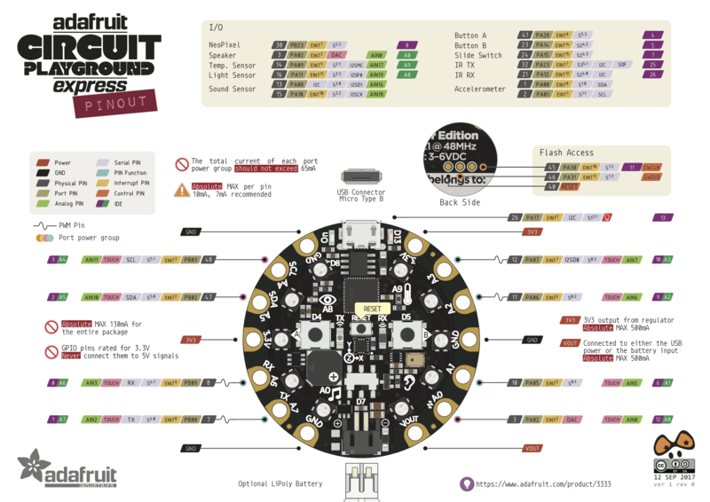
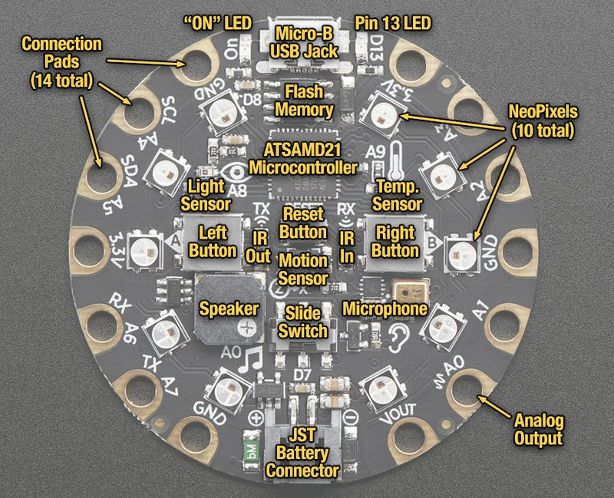
The Board…

Slide 5
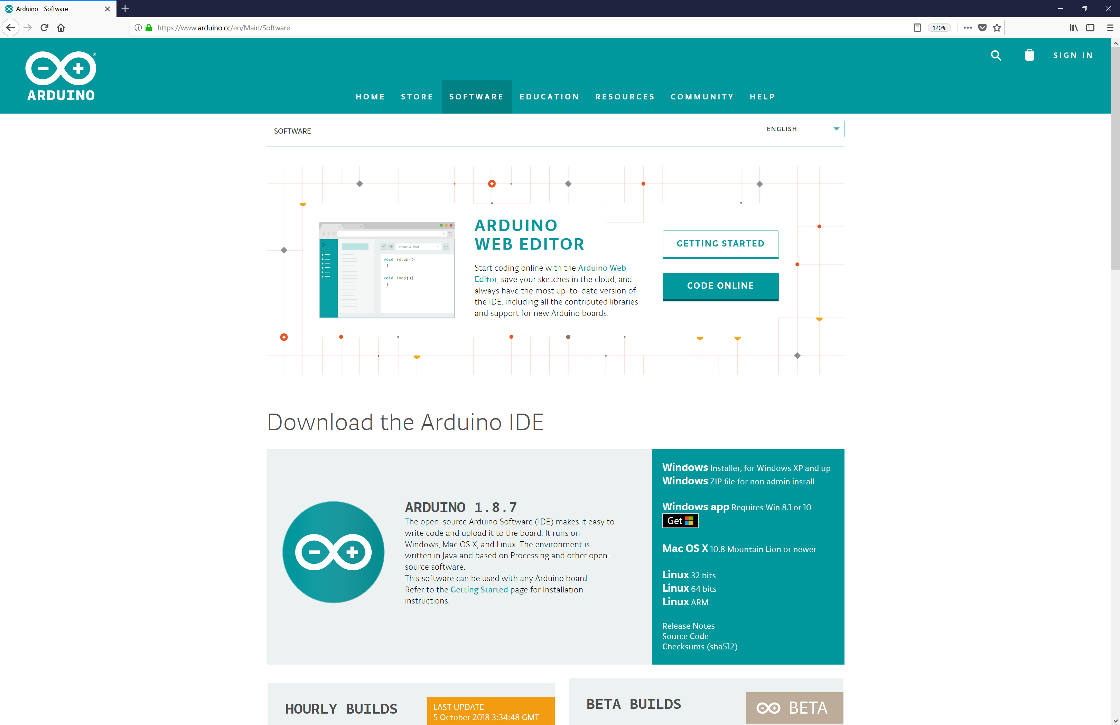
Getting the Arduino IDE
https://www.arduino.cc/en/Main/SoftwareVisual
Download and install the version for you

Slide 6
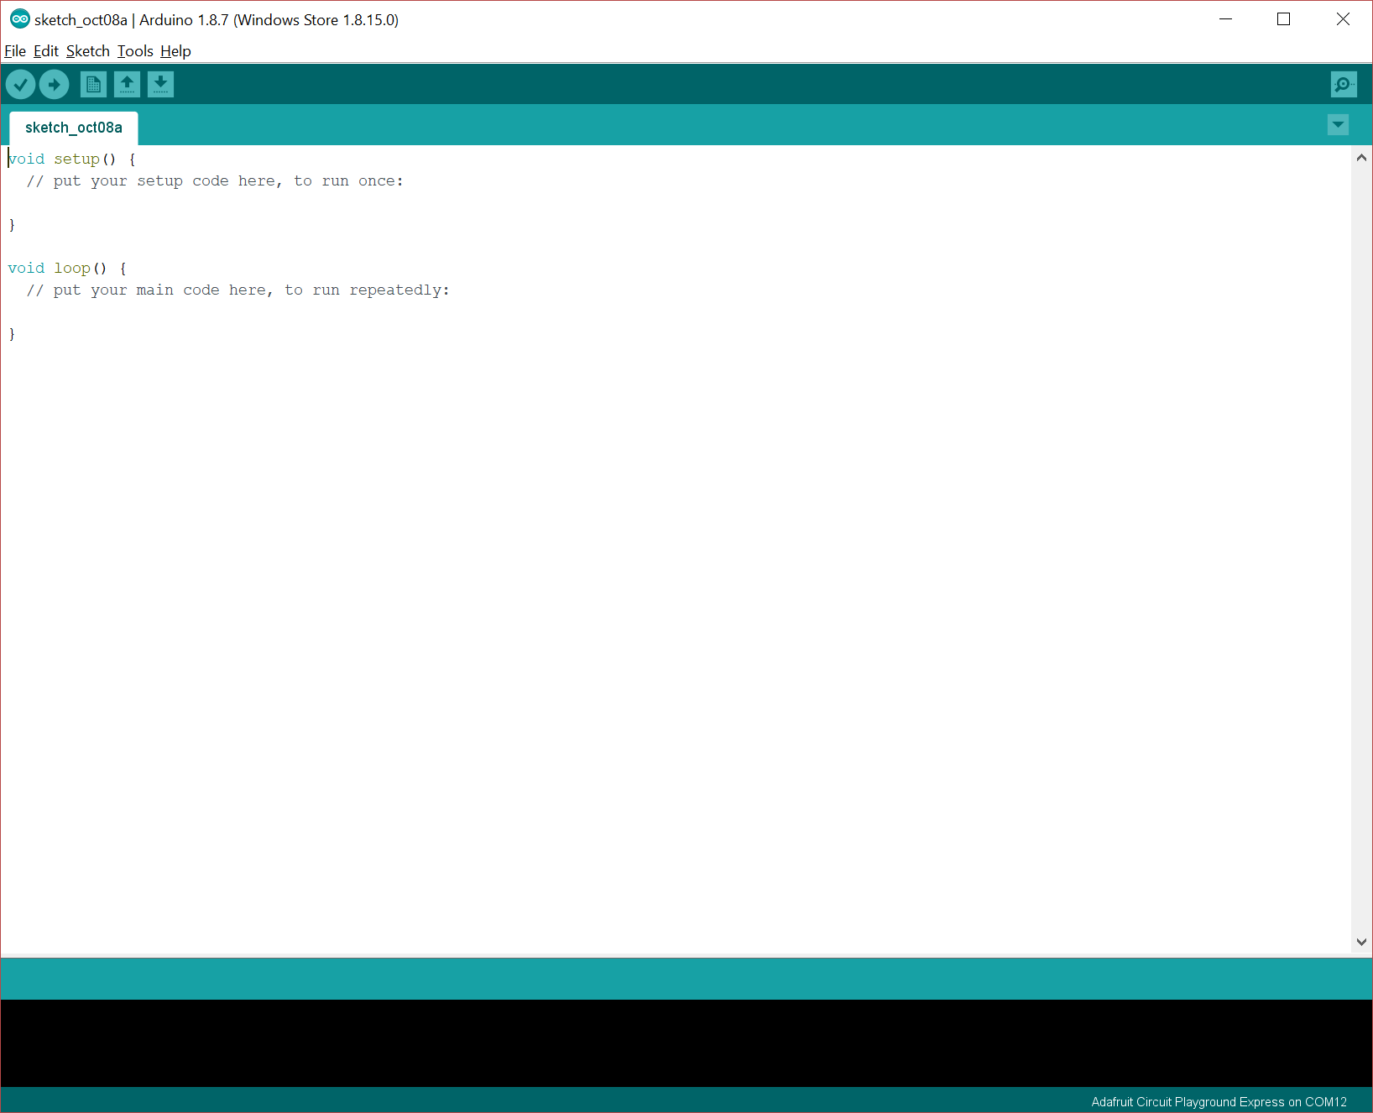
Run the Arduino IDE
Run the IDE, you should see…

Slide 7
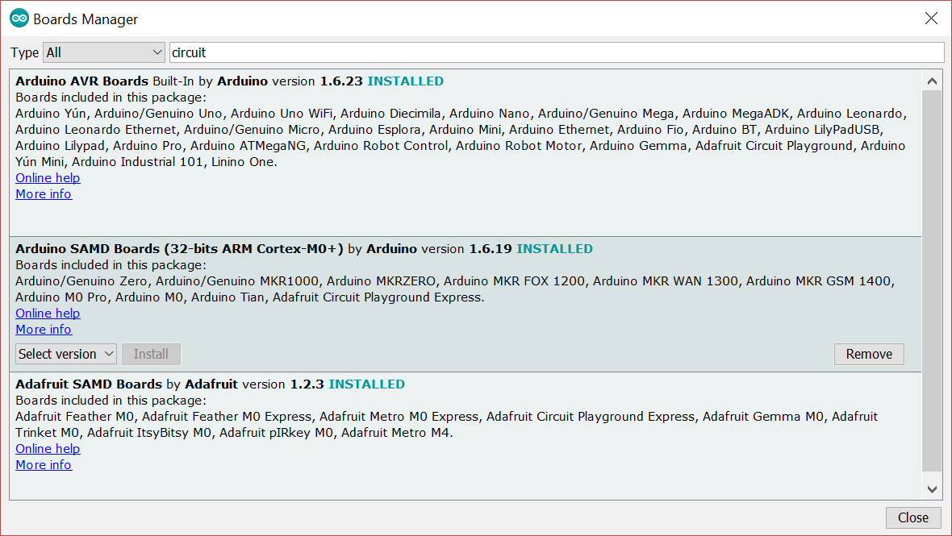
Add support for the board
Select Tools > Board: > Boards Manager
In the search bar, enter circuit
Arduino SAMD Boards > Install both

Slide 8
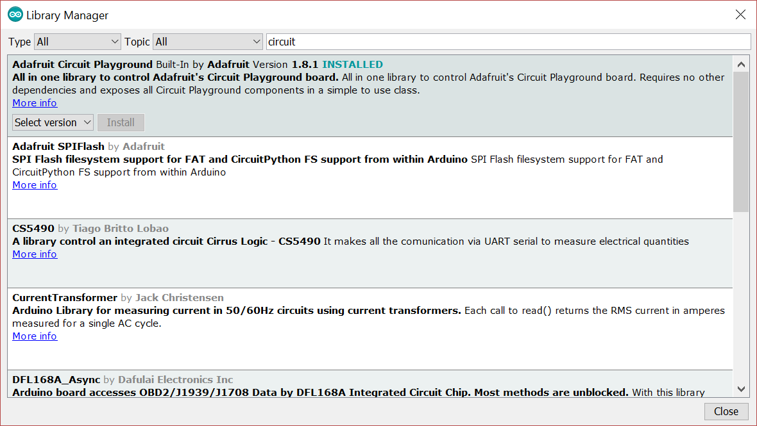
Add the board libraries
Select Tools > Manage Libraries
In the search bar, enter circuit
Adafruit Circuit Playground > Install

Slide 9
Test it out! (I)
Plug the USB cable into the board and your computer
The board should light up when powered
Select the board from the board manager
Tools > Board > Adafruit Circuit Playground Express

Slide 10
Test it out! (II)
void setup()
{
pinMode(13, OUTPUT);
}
void loop()
{
digitalWrite(13, HIGH);
delay(1000);
digitalWrite(13, LOW);
delay(1000);
}

Slide 11
Have Fun!
Additional Information
https://learn.adafruit.com/circuit-playground-lesson-number-0
More ideas
https://learn.adafruit.com/category/circuit-playground
CSGirls on GitHub?
Coming soon

